Slide 1
Strong Password Generation Based On User Inputs
By: Santosh B. Doiphode
Student OF 3rd year Computer Dept. at JSPM NTC,Pune.
Guided By: Dr. Sulochana Sonkamble Maam

Slide 2
Agenda
Introduction
Abstract
Literature Survey
System Architecture
Experimental Evaluation
Conclusion
Future work
References

Slide 3
Introduction
Internet security is recently becoming a significant issue with the increasingly wide range of internet applications.
Bank and commercial exchanges are now being carried out online in the form of internet banking and commercial electronic transactions.
One problem is that it is easy for the attackers to guess passwords whenever the users often choose personal information, such as their ID or telephone number as passwords.
Another problem is that users rarely choose passwords that are both hard to guess and easy to remember.
When users create different passwords for different accounts, they need to remember several passwords which may be problematic or confusing for them during use.

Slide 4
Introduction
We have proposed an automated system to generate user-friendly and robust passwords by combining some texts and numbers.
These passwords will be made from the user given information. So we can assume that they will be easier to remember than randomly generated online passwords.
The generated passwords are unconjecturable because of the features of our methodology and can be used in many and different applications and internet services like social networks, secured systems, distributed systems, and online services. Our proposed password generator can achieve diffusion, randomness, and confusions which are very necessary and required in case an intruder tries to crack the generated passwords.

Slide 5
Abstract
Every person using different online services is concerned with the security and privacy for protecting individual information from the intruders.
Many authentication systems are available for the protection of individuals’ data, and the password authentication system is one of them.
Due to the increment of information sharing, internet popularization, electronic commerce transactions, and data transferring, both password security and authenticity have become an essential and necessary subject.
But it is also mandatory to ensure the strength of the password.
We also have examined that our generated passwords can defend against two password cracking attacks named the “Dictionary attack” and the “Brute Force attack”.
We have implemented our system in Python programming language

Slide 6
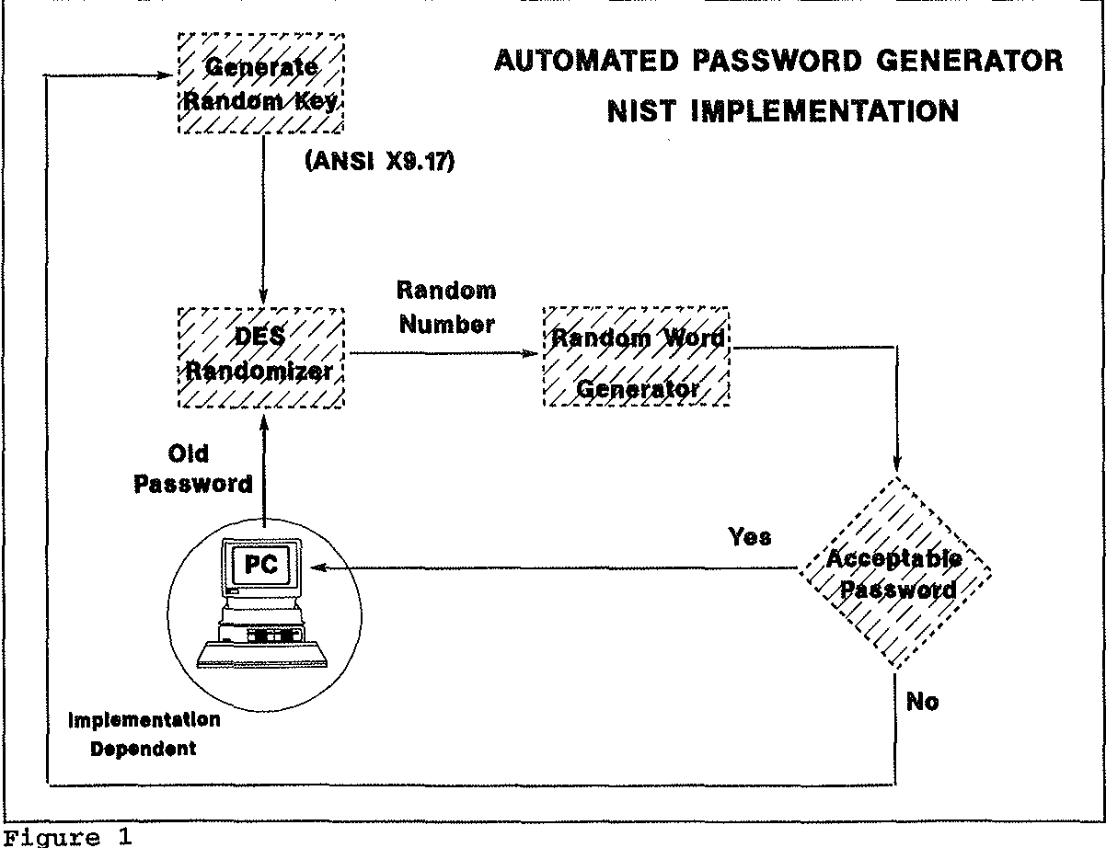
System architecture

Slide 7
System architecture
Inputs will vary from individual to individual, and for this reason, passwords cannot be compromised easily.
Input data provided by the user will consist of different interesting pieces of information such as favourite novel’s name, the number of grand mother’s children, secret dates etc.
For ensuring security from the intruders, these data should ideally never have been exposed to any kind of social media.
We propose an efficient algorithm to generate a strong password based on the provided information so that the adversary can not identify the password using different cracking algorithms.

Slide 8
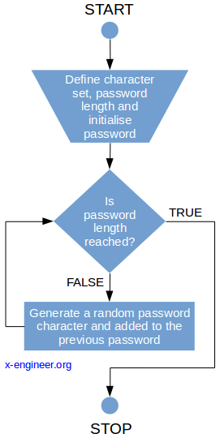
Experimental Evaluation

Slide 9
Experimental Evaluation
At first, we take input information from the user who is asking for a password.
The input information consists of five texts and any two numbers.
If we take only two texts as input, our system will use these two texts for password generation.
So from the security perspective, we have increased the number of texts to five where it can ensure some randomness for password generation.
Now, think about the case if the number of input texts increases from five to ten for password generation.

Slide 10
Experimental Evaluation
We can say that this input will be very secured as it will have more randomness than using five input texts.
But from the user’s perspective, inputting this large number of texts can make the process slow and complicated and also can annoy the users.
So we have picked the number “5” for texts .
Here the term “text” means the user can provide a word or multiple words written together (words should be merged without using space)

Slide 11
Conclusion
In our proposed system, we are generating passwords by prompting the users to provide us with some texts and numbers (which they can easily remember) as inputs.
Our generated passwords have ensured the minimum criteria of the password strength.
Our generated passwords are different from the passwords of other online random password generators as they are not produced entirely at random. Instead, they are created from the inputs given by the user.
They can be easily remembered as they contain only the texts and numbers which the users want to use in their passwords and can not forget easily.
We also have experimented that our generated passwords can defend against the dictionary and the Brute Force attacks.

Slide 12
Future work
There is another password cracking attack named “the social attack” which has not been covered in our work.
In the future, we will extend our work and devise a method so that our generated passwords can defend against the social attack.
Through another user study, we can also get feedback from the users to evaluate whether they can remember the passwords or not.
We also have plans to add more features and steps to our algorithm to strengthen our system.
We will also make it open source for the user’s convenience.

Slide 13
References
1] Richard Shay, Saranga Komanduri, Patrick Gage Kelley, Pedro Giovanni Leon, Michelle L Mazurek, Lujo Bauer, Nicolas Christin, and Larrie Faith Cranor. Encountering stronger password requirements: user attitudes and behaviors. In Proceedings o f the Sixth Symposium on Usable Privacy and Security, page 2. ACM, 2010.
2] Michelle L Mazurek, Saranga Komanduri, Timothy Vidas, Lujo Bauer, Nicolas Christin, Lorrie Faith Cranor, Patrick Gage Kelley, Richard Shay, and Blase Ur. Measuring password guessability for an entire university. In Proceedings o f the 2013 ACM SIGSAC conference on Computer & communications security, pages 173—186. ACM, 2013
https://en.wikipedia.org/wiki/Password_policy
http://password-checker.online-domain-tools.com/
http://www.passwordmeter.com/.

Slide 14
Thank You!!

